Slide 1
Strides n Stripes
Unleash your inner beast!

Slide 2
Concept
Strides n Stripes revolves around the concept of mimicking a tiger's hunting instincts through running.
Users select their "prey" (distance) and embark on a journey to "hunt" them down.
Running plans are categorized based on the user's fitness level: Newborn, Cub, Adolescence, and Adult.

Slide 3
Features
Virtual Prey: Set your targets and track your progress as you chase down your virtual prey.
Running Plans: Choose from Newborn to Adult(beginner to expert) plans for a customized fitness journey.
Rewards and Badges: Earn rewards and unlock badges as you conquer challenges and reach milestones.

Slide 4
How It Works
Step 1: Select Your Plan(Newborn, Cub, Adolescence, or Adult).
Step 2: Choose Your Prey (Challenge).
Step 3: Start Hunting: Begin your run and track your progress in real-time.
Step 4: Achieve Your Goal: Once you've reached your target, claim your kill and celebrate your victory!

Slide 5
Initial Design

Slide 6
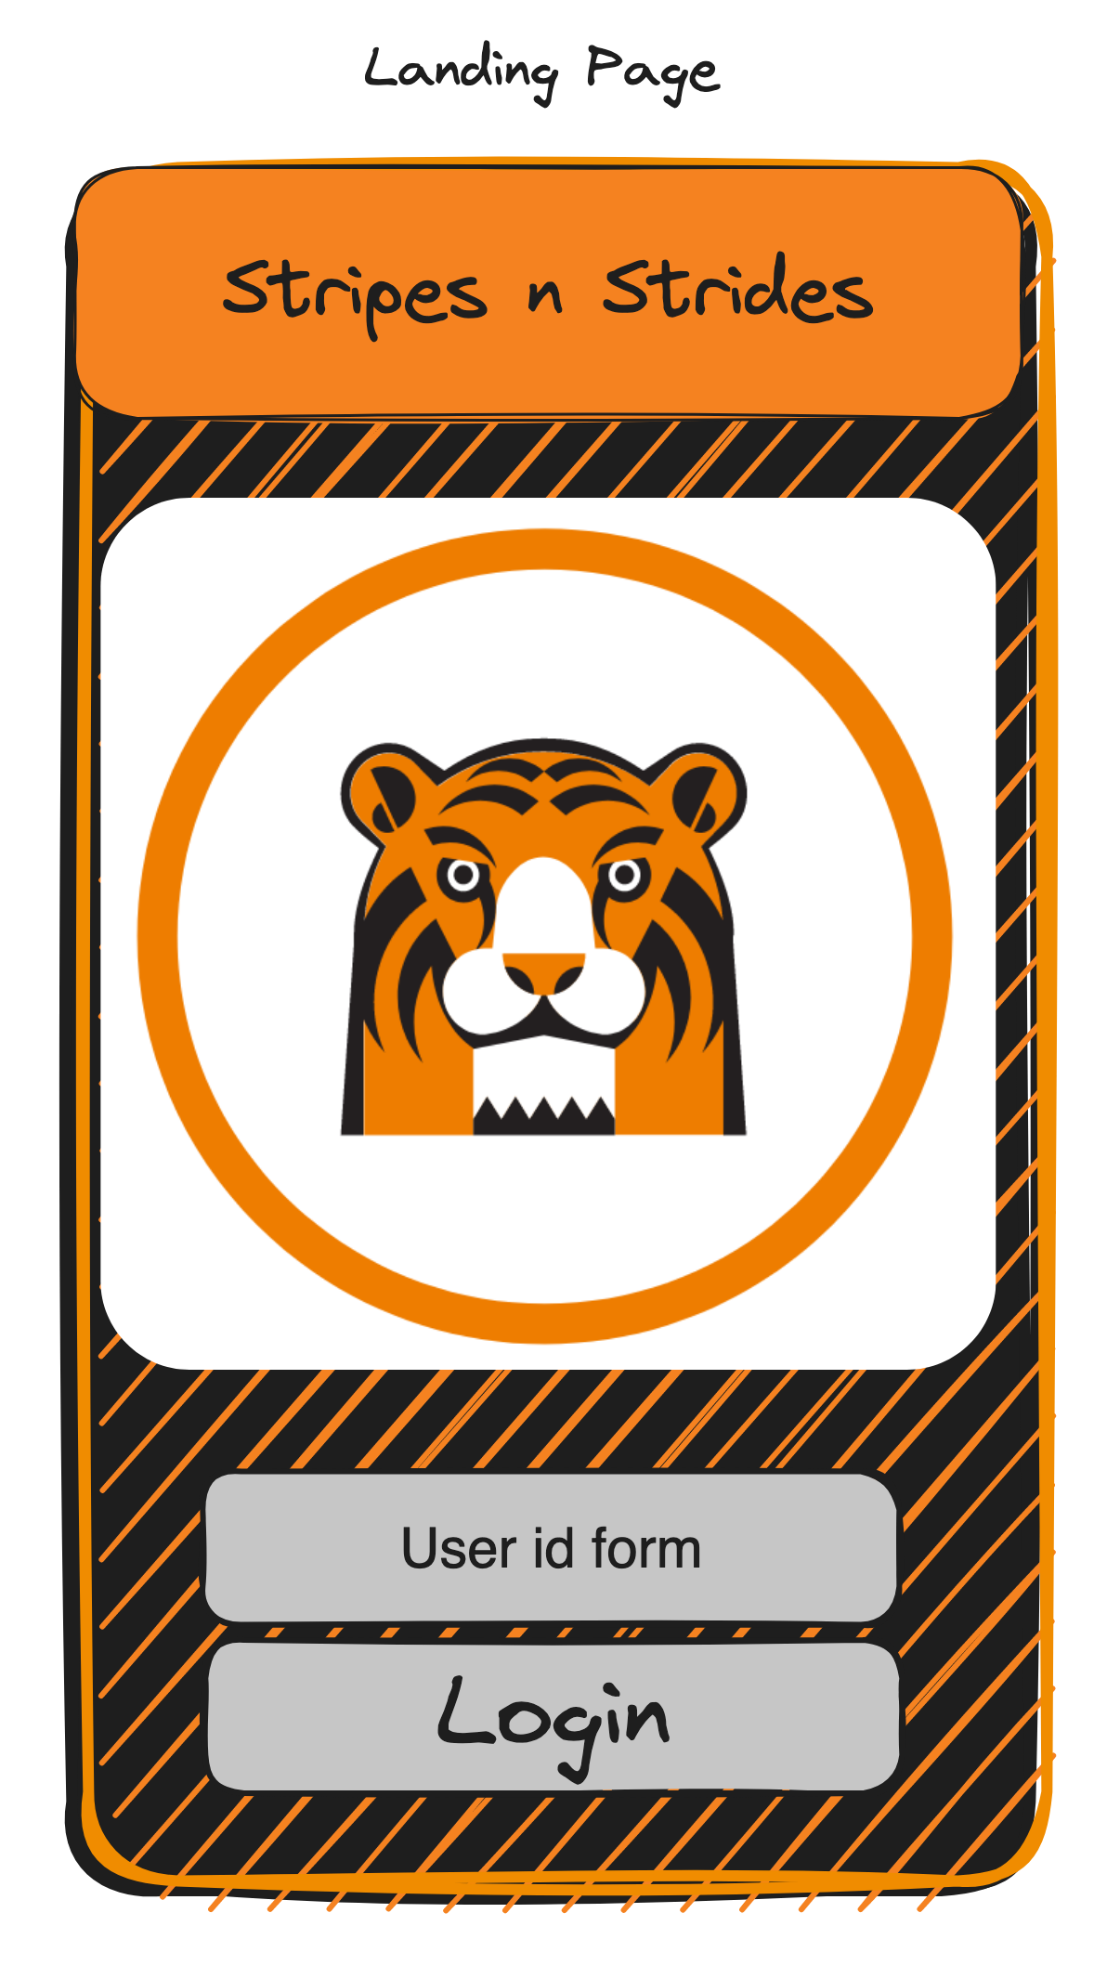

Slide 8
Time for the demo!

